Slide 1
IPL 2018 Prediction
By Team ‘Ee Sala Cup Namde’

Slide 2
WHAT WE DID
The problem was split into 3 phases :
Data Collection -
Kaggle - Past IPL data
IPLT20.com - Schedule
Cricbuzz - Player Stats
Data Preparation -
Computed probabilities for each (batsman,bowler) in the final list of players
Handled missing values for aforementioned list
Performed ‘Random Dart’ Transformation
Prediction - Simulated the entire season ball by ball by generating random values which decided what would occur on that particular ball.

Slide 3
ReSults
#Points table
#Champions
#Orange and Purple cap
#Rain

Slide 4
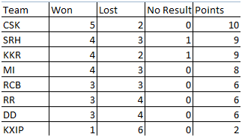
MID SEASON POINTS TABLE
Simulation yielded the following mid season table -

Slide 5
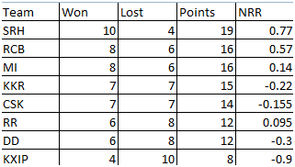
END SEASON POINTS TABLE
At the end of the league, the points table is predicted to be-

Slide 6

PLAYOFFS

Slide 7
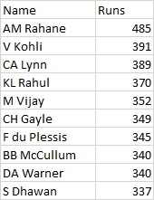
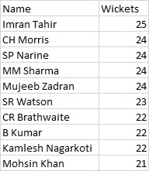
ORANGE & PURPLE CAP
Orange cap - Ajinkya Rahane (RR) Purple Cap - Imran Tahir (CSK)

Slide 8
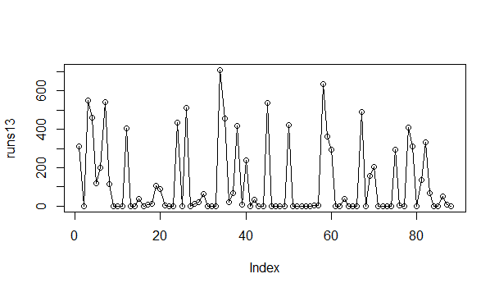
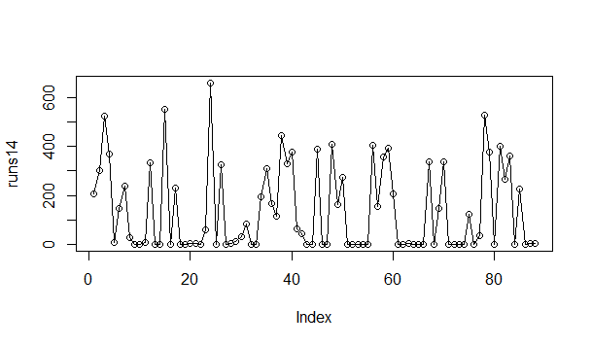
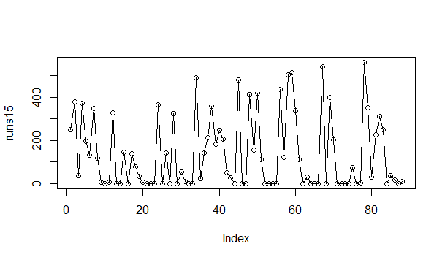
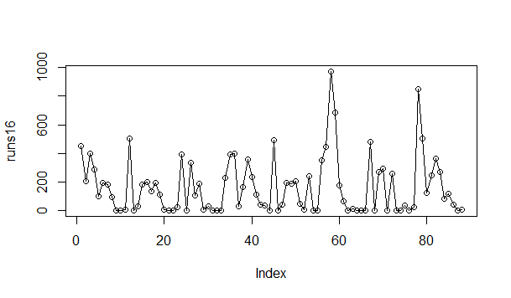
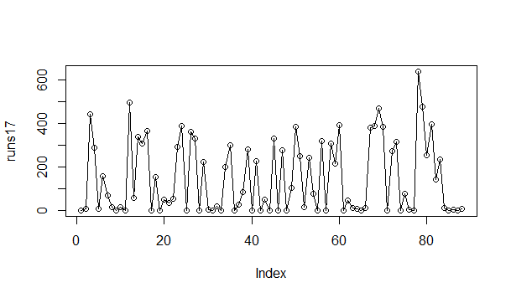
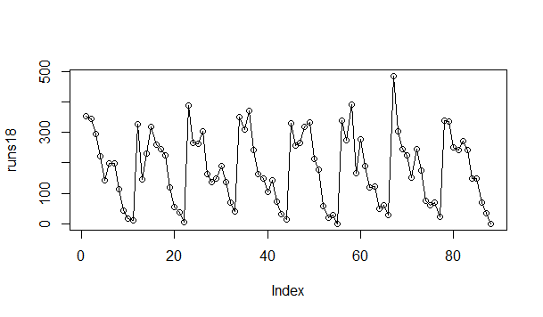
Runs

Slide 9
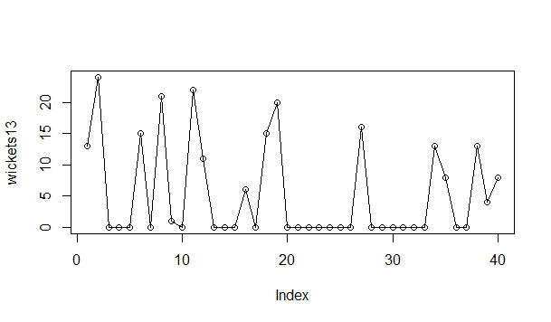
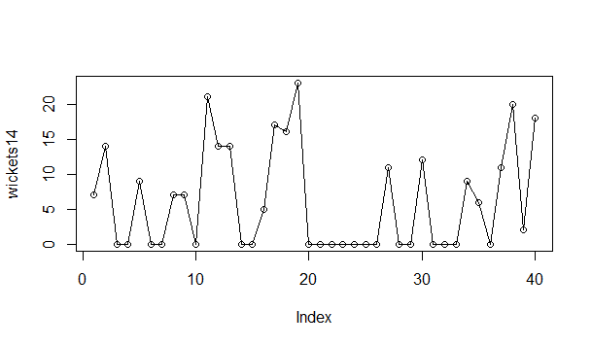
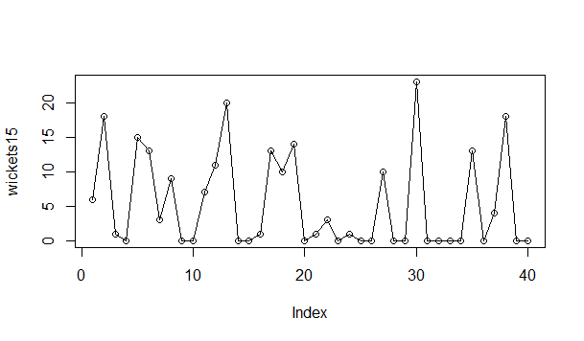
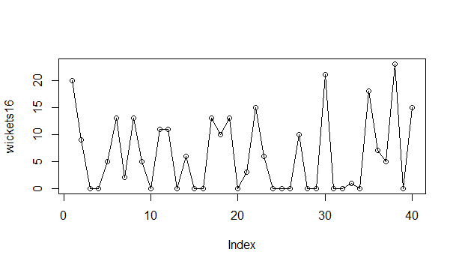
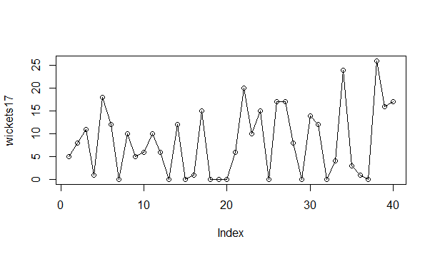
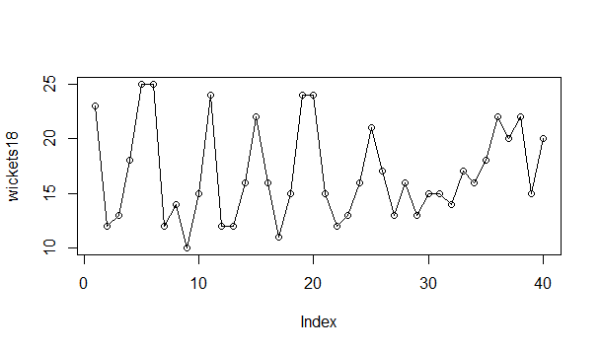
Wickets

Slide 10
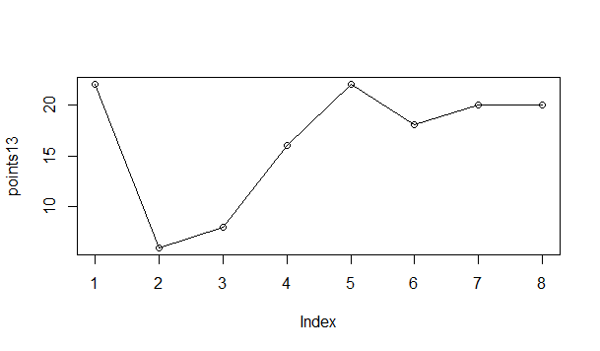
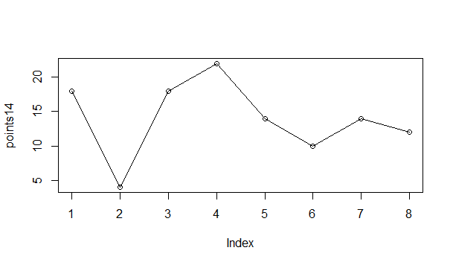
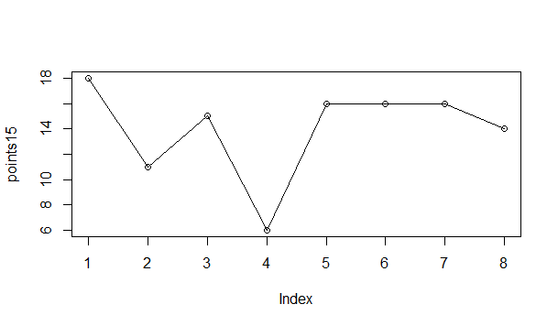
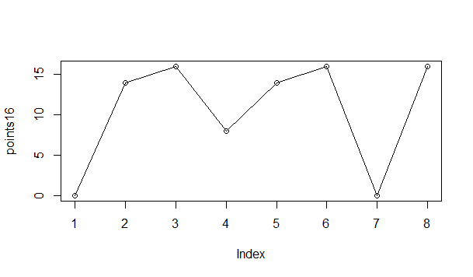
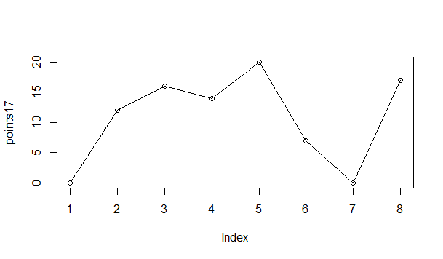
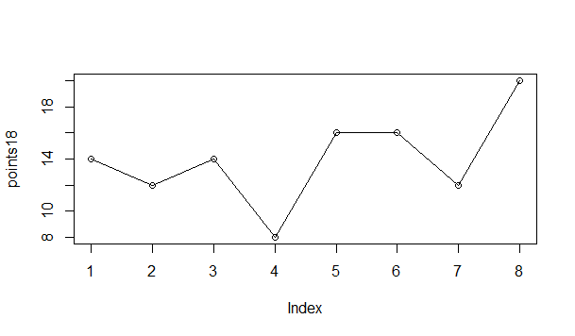
Points

Slide 11
Parameters
DRS has been brought into IPL.
National Duty.
Morale of the team , at the start of the season.

Slide 12
Scalability
How can finding the IPL 2018 champions help CISCO ?
A similar procedure can be followed by Cisco in Data Analytics applications such as :
Prediction of sales and therefore inventory management .
Failure prediction.
HR (Workforce Management).

